Slide 1

List Comprehension

Slide 2
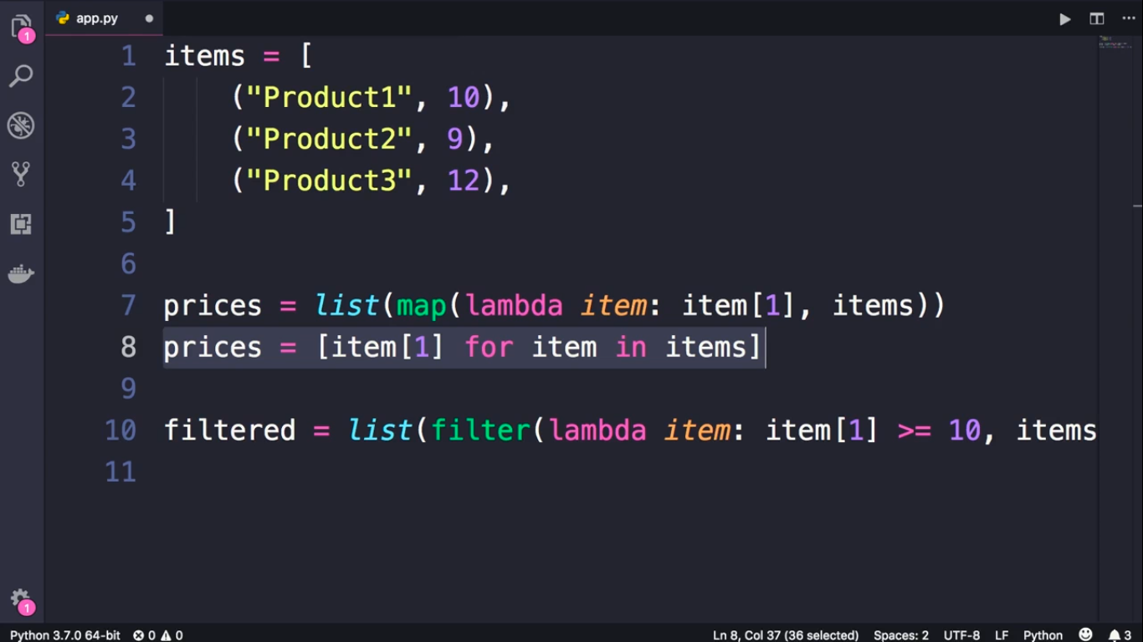

Slide 3
